Slide 1
Continuous Integration
Travis Rosen

Slide 2
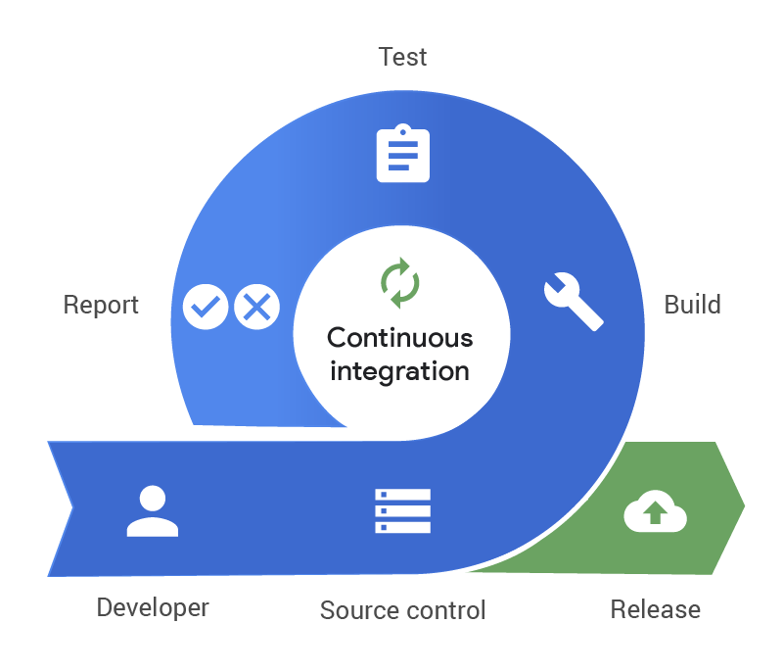
What is CI?
CI, or continuous integration, is a DevOps principle in which developers constantly implement code changes into a central repository. This is done after the developers have run tests on the new code to be implemented. CI often refers to the build or integration stage of the release process.

Slide 3
Goals of CI
Ideally, CI focuses on the goals of quicker bug finds, improvement of overall quality, and reduce time needed to release new changes.

Slide 4

How is CI best used?
CI is fantastic when used alongside agile methods and workflow. When tasks are distributed to developers, CI enables an independent and parallel working environment.

Slide 5
Benefits of CI
Scaling
Improve feedback
Better collaboration and communication

Slide 6
Benefit - Scaling
CI allows for environments to scale in many ways. This includes, but not limited to, development team size, code size, and infrastructure. CI removed dependencies between development of individual features and minimizes code integration bureaucracy.

Slide 7
Benefit - Feedback
Because developer teams can test ideas quicker and more efficiently, CI is able to create a faster feedback loop. Changes are quickly pushed, and issues are quickly addressed.

Slide 8
Benefit - Collaboration
CI creates an environment that encourages better communication and accountability. There is common knowledge that is learned passively through a CI platform.

Slide 9
Disadvantages of CI
While the benefits of a CI certainly outweigh that of the drawbacks, it is important to be aware of the disadvantages. A CI platform comes with tools and technologies that will take developers time to learn and understand fully. These systems could include version control systems, hosting infrastructure, and other technologies.

Slide 10
CI Best Practices
Test Driven Development
Pipeline Speed

Slide 11
Test Driven Development
It is massively important to have test driven development when using CI. Each change in code should have tests ran constantly to ensure its quality.

Slide 12
Pipeline Speed
The speed at which things are completed within teams needs to be executed at a high rate.

Slide 13
Resources
Atlassian. (n.d.). What is continuous integration. Atlassian. https://www.atlassian.com/continuous-delivery/continuous-integration#:~:text=Continuous%20integration%20(CI)%20is%20the,builds%20and%20tests%20then%20run.
Freeman, E. (2019). Devops. Amazon. https://aws.amazon.com/devops/continuous-integration/.

